Slide 1
Entrepreneurship
SLS 1102 Warrington Welcome
Ashton Palmieri

Slide 2
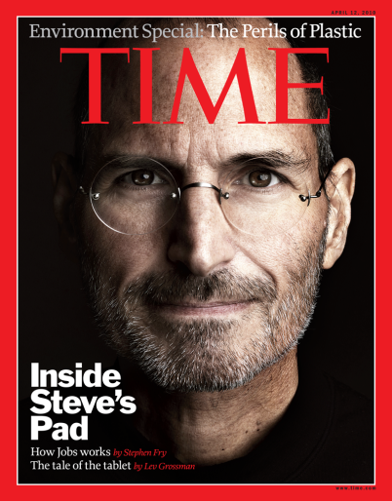
What is Entrepreneurship?
Seizing new opportunities
Taking risks
Transforms innovations into a profitable good using business skills
http://www.youtube.com/watch?v=lZKhZmvJuZY

Slide 3
Business Plans
Crucial to business success
Outlines a route the company wishes to take to grow revenue
Contains business goals, why the goals are attainable, and the plan for reaching the goals
Typically, plan 3-5 years

Slide 4
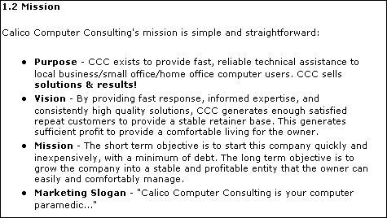
Example

Slide 5
How does this relate?
Jackson had a vision for a school for AIDS orphans
Using business skills, he funded, constructed, and expanded the school
Tenacious, passionate, and ethical
http://www.youtube.com/watch?v=xdMWZR9tuVw

Slide 6
Discussion
What was the biggest obstacle, to you, that Jackson had to overcome to build the school?
What sort of business strategies were used?
Why do you think the “holistic” approach worked for these students? How does that relate to entrepreneurship?

